Slide 1


Loan Management System (LAMA- LUMA)
Under the Guidance of
Nilay Das
Amith G
Bhanu Prakash Pebbeti
Fahadh Kasala
Praveen Singh
Vishal Verma

Slide 2
PROBLEM STATEMENT
Design and develop a comprehensive Loan Management System that caters to the loan application and approval process for employees within a company. The system aims to streamline the loan request and approval workflow, ensuring efficient communication and user-friendly experiences for both applicants and administrators.

Slide 3
SOLUTION
A growing company wants to automate its loan application process for employees. Currently, the process involves manual submission of loan applications, followed by approval from relevant administrators. This manual approach is time-consuming and prone to errors. So we aims to develop a web-based Loan Management System that facilitates the loan submission, approval, and communication processes.

Slide 4
ROLES & FUNCTIONALITIES IN THE APPLICATION
Admin Functionalities:
Admin can register the users by navigating to add users page.
Admin can also add the items in the items list of different categories.
They can also add list of loan cards for each items by entering loan duration.
After user applied for loan card, admin can see the list of all the loans with the their status and they can either accept or decline the request.
They can also view the list of users and delete any user from the database.

Slide 5
ROLES & FUNCTIONALITIES IN THE APPLICATION
User Functionalities:
User can login to the page using the email ID and password.
User can reset their password using, Forgot your password Tab.
They change the info in Your Profile menu, including their email ID and password.
User can apply for the loan for the item by clicking on the loan card.
They can also view the status of the loan applied on the item page.

Slide 6






TECHNOLOGIES USED
.(A) Backend:
Spring Boot, Spring Data JPA
MariaDB (database)
J-Unit
REST APIs
Postman
(B) Front End:
ReactJs
HTML & CSS
Bootstrap
(C) Language Used: Java
(D) Build Tool: Maven
(E) Version Control System: Git

Slide 7
PROJECT MODULES
(1) Login Page:
User is provided with the login page. For successful login, user has to enter the correct email ID (as username) and password, this will redirect them to the Home page based on the roles saved for the user in the database.
For unsuccessful login, it will pop the error message in the login page.
(2) User Menu :
Once the admin is successfully logged in, they get the tabs that navigate them to Loan Dashboard, Employee Details and Item master details page.
(3) Loan Card Details Management:
As an Admin, they can create a new loan card on the item’s page by just entering the duration of the loan (in months).
Once the data is entered in the database, it will redirect to the item’s page where it will show the loan cards and admin can also edit and delete them.

Slide 8
PROJECT MODULES
(4) Employee Data Management :
As an admin, they can create a new employee; with name, designation, department, gender, DOB, DOJ and email ID.
Admin can also edit and delete the existing data.
(5) Item Master Management :
Admin can add a new item in the system with details as item name, description, make, category and valuation.
Once data is added, admin can again edit or delete the item from the database.
(6) Apply for loans :
Once, the employee is signed in successfully, they can view the items and can apply for the loan cards added by the admin.
After applying, they will be redirected to items page and can view the loan cards they have applied.

Slide 9
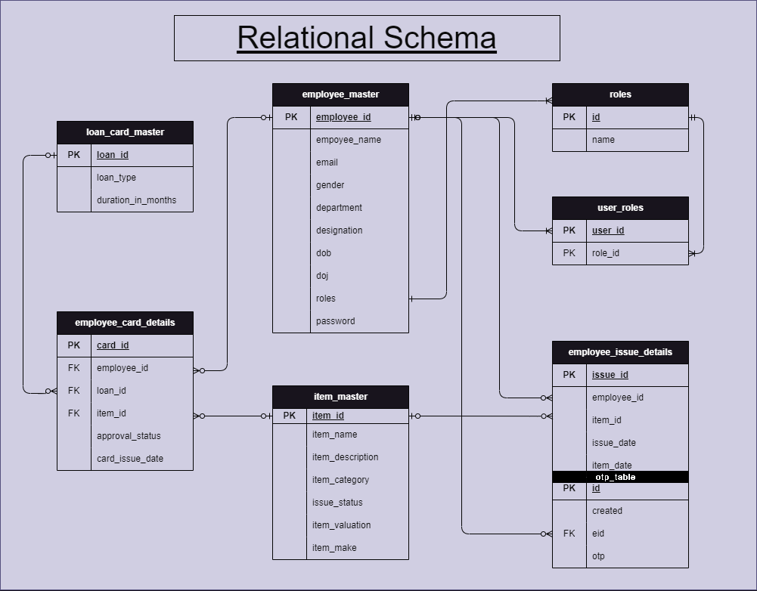
RELATIONAL SCHEMA

Slide 10
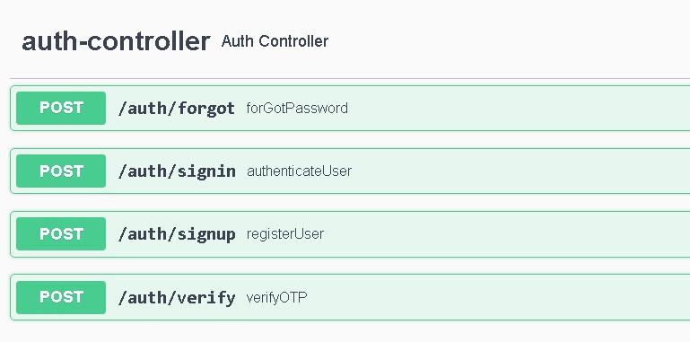
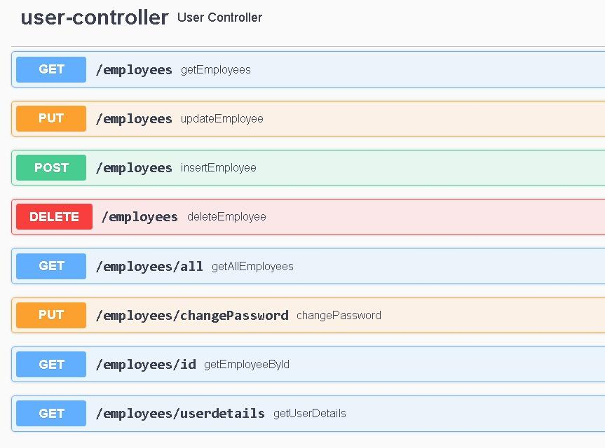
API ENDPOINTS

Slide 11
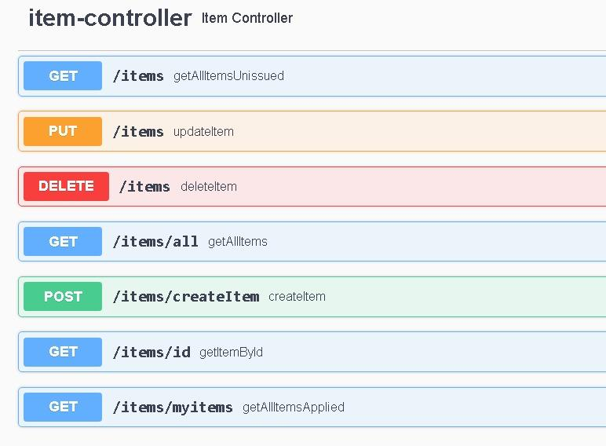
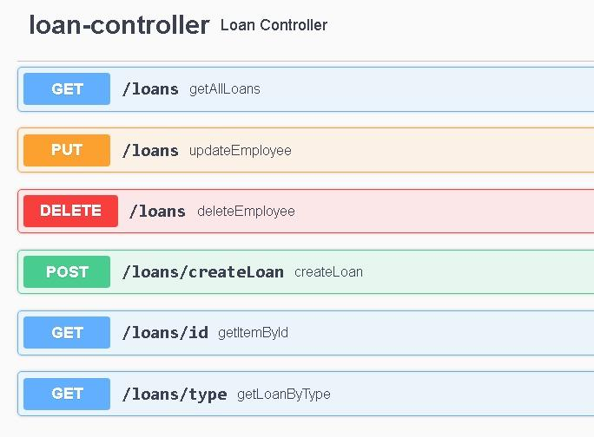
API ENDPOINTS

Slide 12
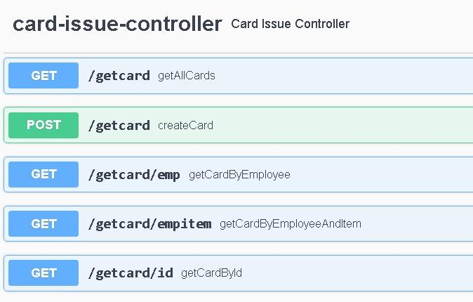
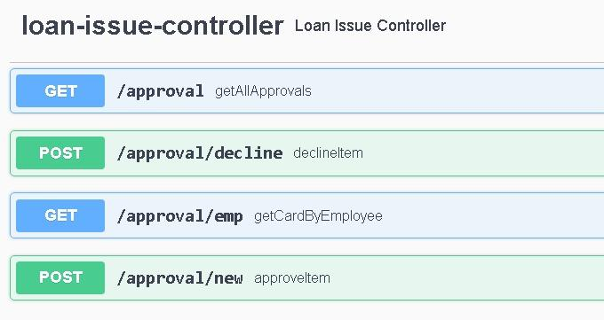
API ENDPOINTS

Slide 13
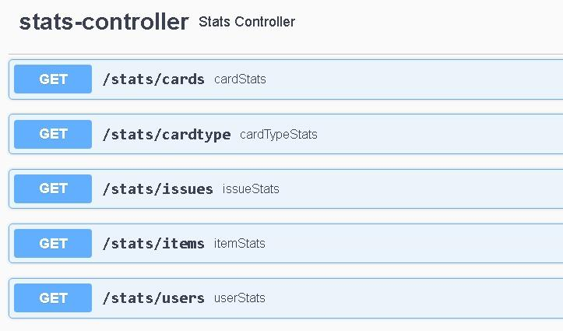
API ENDPOINTS

Slide 14


Slide 15

CONCLUSION
Streamlined Workflow
User-Friendly Interface
Data Security and Integrity
Robust Data Management
Fast and Easily Accessible
Availability
Portability

Slide 16

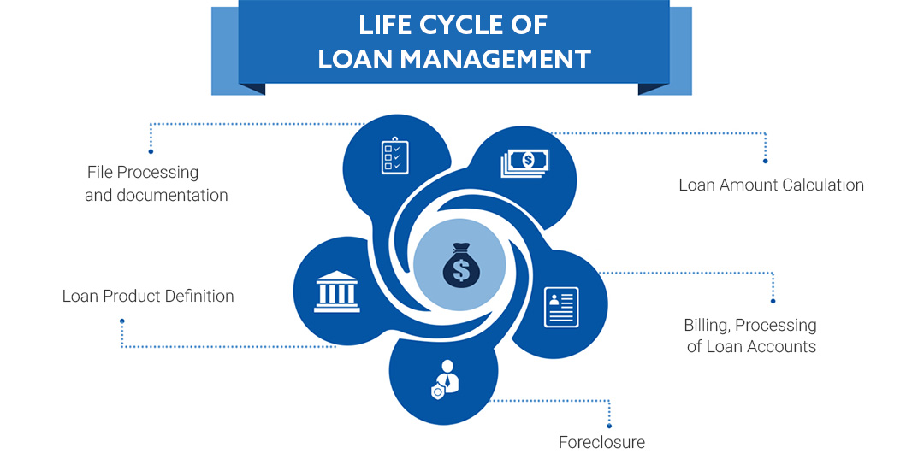
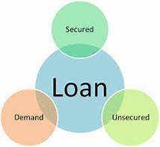
FUTURE WORK
Advance Reporting and Analytics
Integration with payment gateway
Admin can add the custom images of the product.
User feedback and survey
User Interface Enhancement

Slide 17
REFERENCES
https://spring.io/projects/spring-boot
https://spring.io/projects/spring-data-jpa
https://spring.io/projects/spring-data-rest
https://spring.io/projects/spring-security
https://react.dev/reference/react
https://www.npmjs.com/package/react-axios
https://mariadb.org/documentation/
https://getbootstrap.com/docs/5.3/getting-started/introduction/
https://www.tutorialspoint.com/junit/junit_test_framework.htm
https://www.tutorialspoint.com/junit/junit_test_framework.htm
https://spring.io/guides/gs/spring-boot/
https://git-scm.com/doc

Slide 18
THANK YOU

